Slide 1
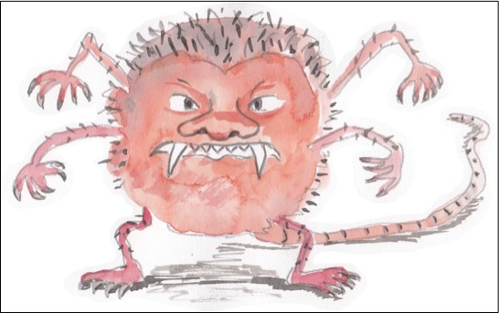
Noun Phrases
Burp!

Slide 2
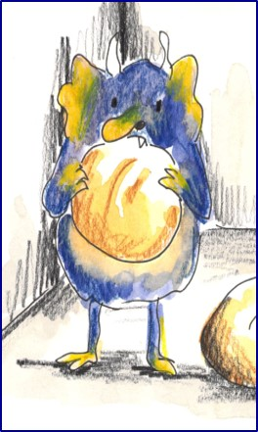
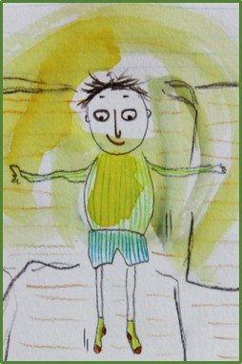
Nouns
A noun names a person, place, idea, thing or feeling.
a monster
the child
an enemy
that sound
In front of a noun, we often have ….
a an the this that his her their my your
Revision

Slide 3
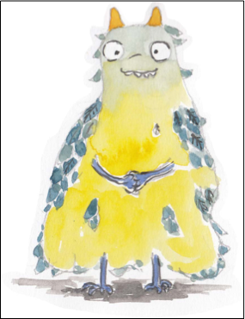
Adjectives
An adjective is a describing word.
It tells you more about a noun.
a terrifying monster
the brave child
an ancient enemy
that scary sound
The monster was prickly.
Adjectives sometimes come next to ‘their’ nouns…
but sometimes they do not.
Revision

Slide 4
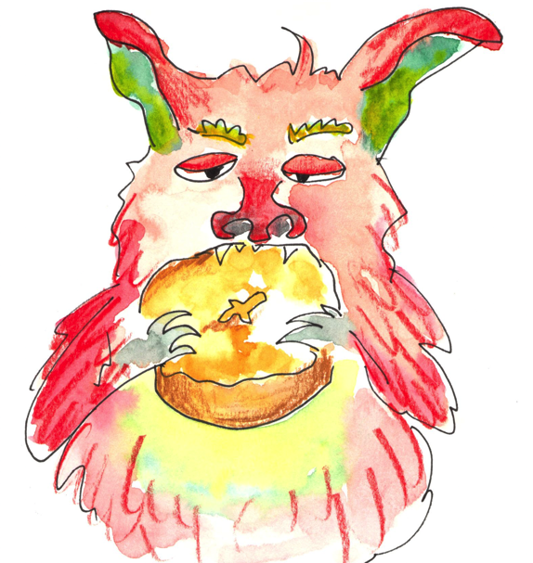
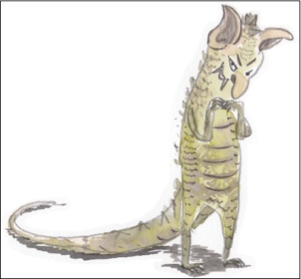
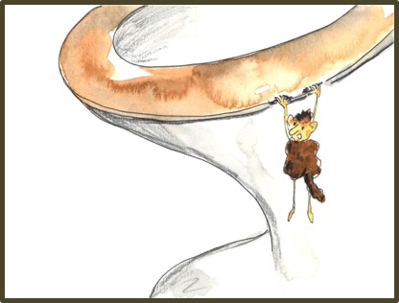
Noun Phrases
Adjectives can add extra detail to a noun.
the hungry, hairy monster
a short and skinny creature
this quite terrifying beast
that really pathetic creature
More than one adjective can be added.
And adverbs can tell us more about the adjectives.

Slide 5
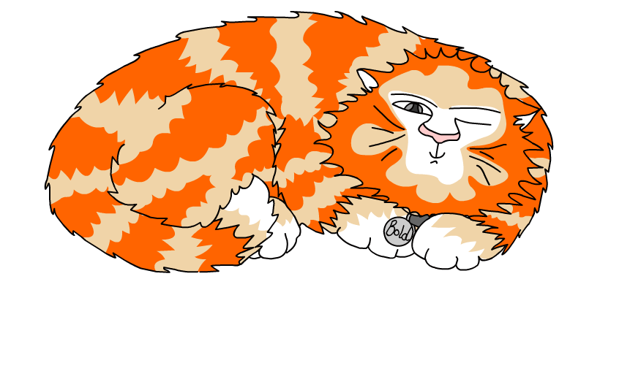
Explore more Hamilton Trust Learning Materials at https://wrht.org.uk/hamilton/ .

