Slide 1
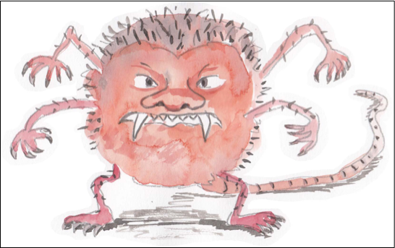
Noun Phrases
Burp!

Slide 2
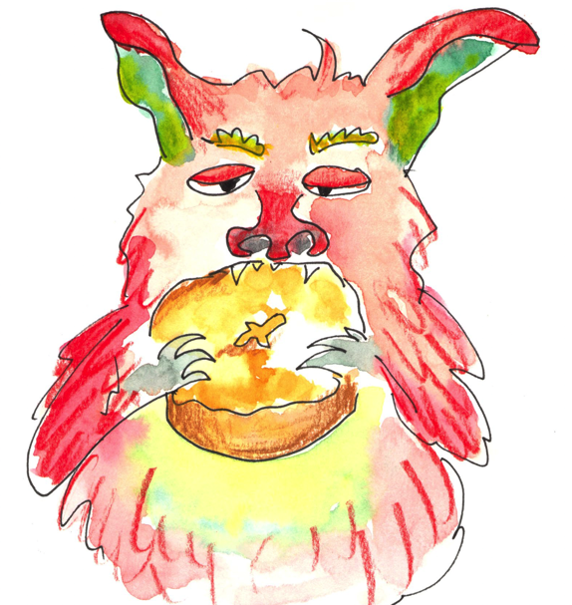
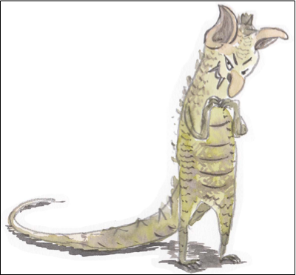
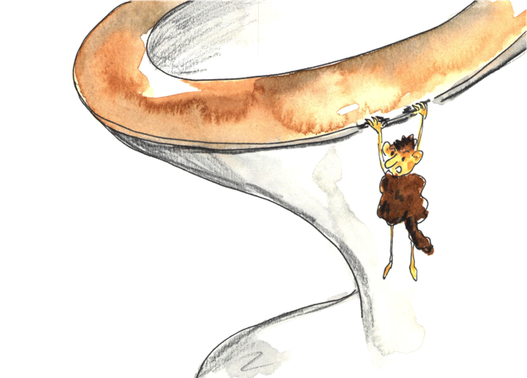
Noun Phrases
Adjectives can add extra detail to a noun.
the hungry, hairy monster
a short and skinny creature
this quite terrifying beast
that really pathetic creature
More than one adjective can be added.
And adverbs can tell us more about the adjectives.

Slide 3
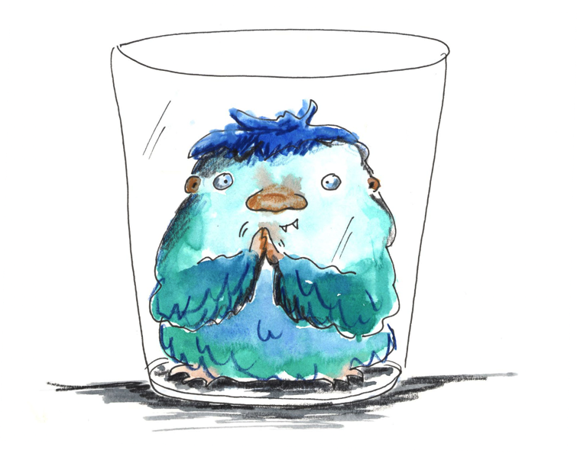
Expanding Noun Phrases using prepositions to start a phrase
inside a glass
on the shelf
under the bed

Slide 4
Prepositions
Prepositions tell us how words are related.
above
of
from
inside
on
with
over
without
outside
between
Prepositions are useful for adding extra information about a noun.
by
under
from
below

Slide 5
Expanded Noun Phrases
Add more description using a preposition as a linking word.
adjectives
The naughty, little monster
The naughty, little monster under the bath.
Useful prepositions
with, of
by, from, on, under, beyond, below, between, inside, next to, over, in, outside
The naughty, little monster between the cupboards.
The naughty, little monster inside the toilet.
The phrase modifies the noun.

Slide 6
Expanded Noun Phrases
creature
Choose a noun
monster
wicked
Think of adjectives
beast
fiend
messy
girl
Add a phrase
starting with a
preposition!
bedroom
cave
Useful prepositions
with, of
by, from, on, under, beyond, below, between, inside, next to, over, in, outside
cat
boy
The phrase modifies the noun.
The wicked, messy creature with long arms hung under the toilet seat.

Slide 7
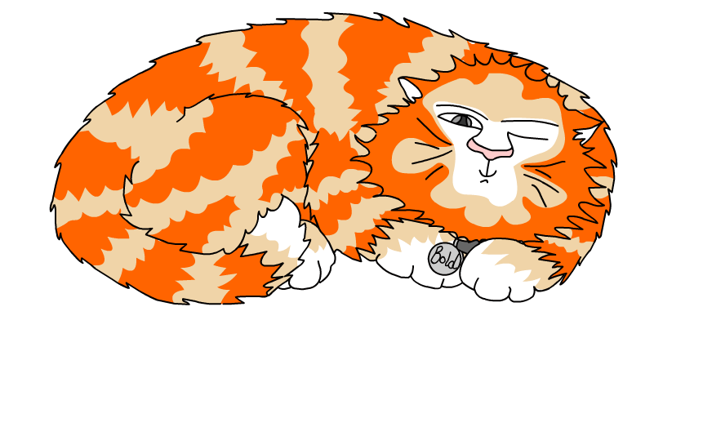
Explore more Hamilton Trust Learning Materials at https://wrht.org.uk/hamilton/ .

