Slide 1
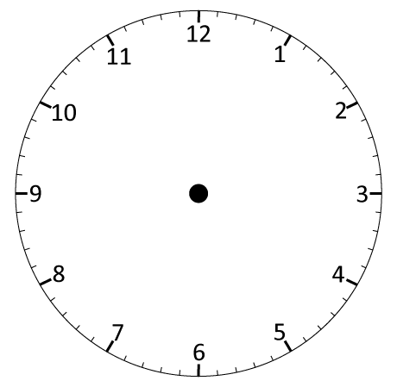
Understand angles as an amount of turn and right angles as quarter turns.
Where does the minute hand point at quarter past?
What about at quarter to?
Where does it point at half past?

Slide 2
Understand angles as an amount of turn and right angles as quarter turns.
Let’s split the clock face into quarters.
This is a quarter of the clock face.
What is the angle between the two straight lines that create it?
It’s a right angle; 90 degrees; 90°.

Slide 3
Understand angles as an amount of turn and right angles as quarter turns.
A right angle is a quarter turn.
When the minute hand moves from 12 to 3, this is a quarter of a turn clockwise.
Turning the other way is
anti-clockwise.

Slide 4
Understand angles as an amount of turn and right angles as quarter turns.
How many right angles do you think make a complete turn around the clock?

Slide 5
Understand angles as an amount of turn and right angles as quarter turns.
1 right angle
2 right angles
3 right angles
4 right angles

