Slide 1
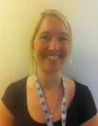
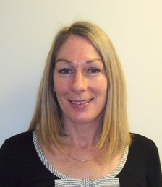
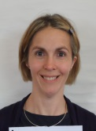
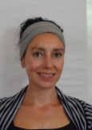
They can be contacted on 01395 226732 Withycombe Centre 89 Withycombe Village Road Exmouth EX8 3AE
Becky Box
School Nurse
Sylviane Evans
School Nurse
Hannah Dearden-Watts School Nurse
Catherine Browning
Community Health Worker
Amanda Balaam
Community Health Worker

Slide 2
Our School Nurses will provide :-
Health assessments and support at key transitions
Providing support to children and young people moving into and between schools
Health protection and promotion
Providing information on how you can protect your health and stay well
Guidance on managing medical conditions in school allowing every child to access every area of the curriculum
Emotional Health and Well being Providing education and support with social and emotional health and wellbeing

Slide 3
From September 2015, we have not been routinely testing children's hearing in Reception. If you have any concerns regarding your child's hearing at any time, please contact the school nurse, class teacher or your GP for further guidance or assessment.
If you have recently moved in from abroad and want to check if your child requires a BCG vaccination, please contact your school nurse for further information.
All children under the age of 16 are eligible for free dental care and vision checks. Please ensure that your child has an annual check-up at the dentist and opticians.
If you have health concerns that impact on your child's schooling, please contact your school nurse

Slide 4
FOR AN APPOINTMENT WITH THE SCHOOL NURSE
Book into one of our Community Clinics either through a referral into our service or by contacting a member of the team.
Phone 01395 226732

